Slide 1




Getting all children to
read well, quickly.

Slide 2




What are we going to cover?
What is Phonics?
What is Essential Letters and Sounds?
How we teach phonics
Getting children ready to read
Supporting your child with reading at home
Pronouncing pure sounds
Using the letter formations and spelling sequence to support writing at home
© Oxford University Press 2021
Notes:
Overview of Essential Letter and Sounds and how it works
Resources – what they are and how they are used
Assessment and Intervention – what does this look like and how is it implemented
Next Steps – what happens next!
We will check the questions in the chat box at the end of the session so there will be plenty of time to answer and queries then

Slide 3
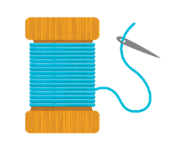
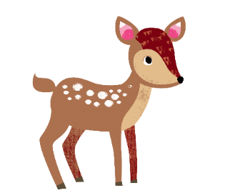
What is Phonics?
A method of teaching beginners to read and pronounce words by learning to associate letters or letter groups with the sounds they represent.
There are 44 main sounds in the English Language. Each sound is represented by a grapheme (the written representation of a sound).
120 graphemes or ways of writing down those 44 phonemes.
say pain same hey weigh veil A
© Oxford University Press 2021
Notes:
Begin by explaining what Phonics is. Explain that learning to read the English language is complex and that this information session will give parents & carers the understanding of what Phonics is, the terminolgy used in Phonics and how ELS gives children the skills and knowledge to read well, quickly.

Slide 4
What is Phonics?
Phoneme: the smallest single identifiable sound in a word.
For example, in the word 'cat' there are three phonemes c/a/t.
Grapheme: the written representation of a sound.
Digraph: two letters making one sound. For example, /sh/ in the word 'shop'.
Trigraph: three letters making one sound. For example, /igh/ in the word 'night'.
ee
tree
cheek
green
sheep
igh
sigh
bright
© Oxford University Press 2021
Notes:
Use flashcards to put this into context. Show parents examples of graphemes, digraphs, trigraphs and split digraphs. Where possible, make the link between same sound, different spelling.
Example:
<a>
acorn
<ai>
rain
<ay>
play
<a-e>
name
<eigh>
eight
<ey>
they
<ea>
great
<aigh>
straight

Slide 5
What is ELS?
Essential Letters and Sounds (ELS) is our chosen phonics programme
Children will experience the joy of books and language whilst rapidly acquiring the skills they need to become fluent independent readers and writers.
© Oxford University Press 2021
Notes:
We use phonemes and graphemes to teach children the code of our language.
English is one of the most challenging languages to learn as there are so many ways to spell the sounds of our language.
We teach children to decode words – by identifying each of the written sounds within the word before blending them together to read the word. This is a challenging process for children to learn and takes time to master. When they are able to decode and blend to....

Slide 6
How do we teach phonics?
We use a simple, consistent approach to teaching phonics.
We have rhymes to support learning and recall
We teach phonics every single day from the first days of Reception. Phonics session is 9.00am everyday!
In lesson catch up
Keep up interventions
Phonics workbooks
Word building
© Oxford University Press 2021
Notes:
Phonics teaches the link between the spoken sounds of our language and the written version of that sound – the code of our language.
As systematic synthetic phonics programme breaks this down into tiny steps for children to piece together which allows them to decode to read and then spell using the sound to spelling correspondences they have learnt.
We use a simple, consistent approach to teaching phonics.
Your child will experience the same classroom routines within each lesson which reduces cognitive load and maximises the chances of success.
All children are supported within the lesson to use their new phonic knowledge independently.
In every single ELS lesson, your child will make the direct application to reading.

Slide 7
How do we teach phonics?
Phonics throughout the day to review new sounds & graphemes taught
Lots of opportunities for oral blending- /c/ /oa/ /t/
We teach the ‘code’ for reading, alongside teaching vocabulary.
Similar methods at home and school
Ask them the sound of the day
Practise the sounds at home
© Oxford University Press 2021

Slide 8
Pronouncing pure sounds
We must use pure sounds when we are pronouncing the sounds and supporting children in reading words.
c a t not cuh a tuh
If we mispronounce these sounds we will make reading harder for our children.
There are videos for this on our school website and dojo class stories where you can hear the correct pronunciation of the sounds.
© Oxford University Press 2021
Notes:
If we use the ‘uh’ sound after the pure sound we are teaching the schwa.
For example instead of /c/ /a/ /t/ we teach /cuh/ /a/ /tuh/ - cuhatuh – not a word! IT makes blending harder if you teach or use a schwa after the initial sound.

Slide 9

How do we teach phonics?
Try at home
Give three things that contain
the sound at home.
I know the word with ng in it
Can we think of another word together
Can you hear the ‘ng’ in sing?
Let’s make other words
© Oxford University Press 2021
Notes:
In ELS we do not ask children questions before we have taught them.
For example, when teaching a new sound, rather than asking children if they know any words with the sound in - we give the children 3 words that contain that sound. You can try this with your children at home.

Slide 10


How do we teach phonics?
Home support
Say the sound, then find it in the word, then decode and blend
Give the children as much or as little support with this.
© Oxford University Press 2021
Notes:
The new teaching is always highlighted so that it is easy for all children to see where the new GPC they have been taught is located. First we say the new sound, then we find it in the word. Finally, we decode and blend. Children have as much or as little support as needed. We want every child to feel confident and successful at each step.

Slide 11

ELS Progression
© Oxford University Press 2021
Notes:
In Reception your children will learn all the single letter sounds and begin to learn diagraphs and trigraphs.

Slide 12

ELS Progression
© Oxford University Press 2021

Slide 13
ELS Progression
© Oxford University Press 2021

Slide 14

Supporting your child with writing at home
You can use the spelling sequence with your children at home to support them with their writing.
Let’s try this with the word: cheek
We also practise saying our sentences before we write them to make sure we write the sentence we have planned and to ensure it makes sense!
ee
see
tree
cheek
green
sheep
© Oxford University Press 2021
Notes:
Use the spelling sequence to model rain
Say the word – warm it up – stretch the word – robot talk the word – blend the word – count the sounds within the word – say the word
You can talk about how you support your children with their writing in school.

Slide 15
Supporting your child with reading at home
Only 1 in 3 children are read a bedtime story night
Reading a bedtime story every night to your child improves their outcomes
If your child views themselves as a ‘good reader’ when they leave Primary School they are more likely to earn a higher salary in their 40s.
© Oxford University Press 2021
Notes:
Reading until they are 3 improves outcomes in YR, reading until they are 5 improves outcomes in Y6 and reading until they are 8 improves outcomes aged 16!
Children who achieved the Early Learning goals for literacy are 11 times more likely to achieve the expected outcomes in Maths at the end of KS2. Reading underpins everything.
We want all our children to leave primary school able to read well and confidently – you can support us in this journey.

Slide 16
Supporting your child with reading at home
Children are only reading from books that are entirely decodable
Your child should be able to read their book confidently
We only use pure sounds when decoding words (no ‘uh’ after the sound)
We want them to practise reading their book 4 times across the week working on these skills:
decode
fluency
expression
© Oxford University Press 2021
Notes:
We want children to only have success when learning to read
Decode – explain this meaning
Fluency – recognising the sound for spelling within the word and blending fluently
expression – model this for the children in school, when reading at home we want children to start to think about expression and intonation. For example, if someone is asking a question let’s get the children to make their voices sound like they are asking a question.

Slide 17

Supporting your child with reading at home
Home school readers
Dojo – Incentive and reward
© Oxford University Press 2021
Notes:
We want children to only have success when learning to read
Decode – explain this meaning
Fluency – recognising the sound for spelling within the word and blending fluently
expression – model this for the children in school, when reading at home we want children to start to think about expression and intonation. For example, if someone is asking a question let’s get the children to make their voices sound like they are asking a question.

Slide 18

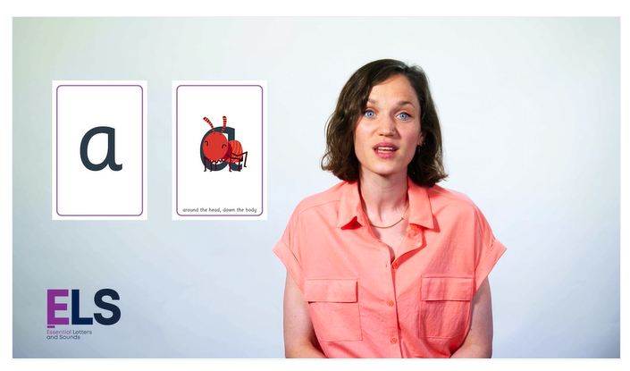
E-book library
Your child’s teacher will invite you to
Join the e-book library.
All reading scheme books are available
Class teachers will allocate a book
Check the website out for more information about phonics and
examples of sound pronunciation.
Sound videos on class dojo stories
and the website

Slide 19
Sounds packs
We will be sending home sound packs to practise all the sounds taught this term and last.
We will add to these packs
Practise the sounds. Try….
Looking for sounds in reading books
Sound talking words
Give instructions by segmenting the word eg pass the cup
Reading 3/4 times at home, children will also read in school
© Oxford University Press 2021
Notes:
If we use the ‘uh’ sound after the pure sound we are teaching the schwa.
For example instead of /c/ /a/ /t/ we teach /cuh/ /a/ /tuh/ - cuhatuh – not a word! IT makes blending harder if you teach or use a schwa after the initial sound.

Slide 20

Check out dojo for phonics ideas and games
Speak to class teachers for further support
Thank you for your continued support.
© Oxford University Press 2021

