Slide 1


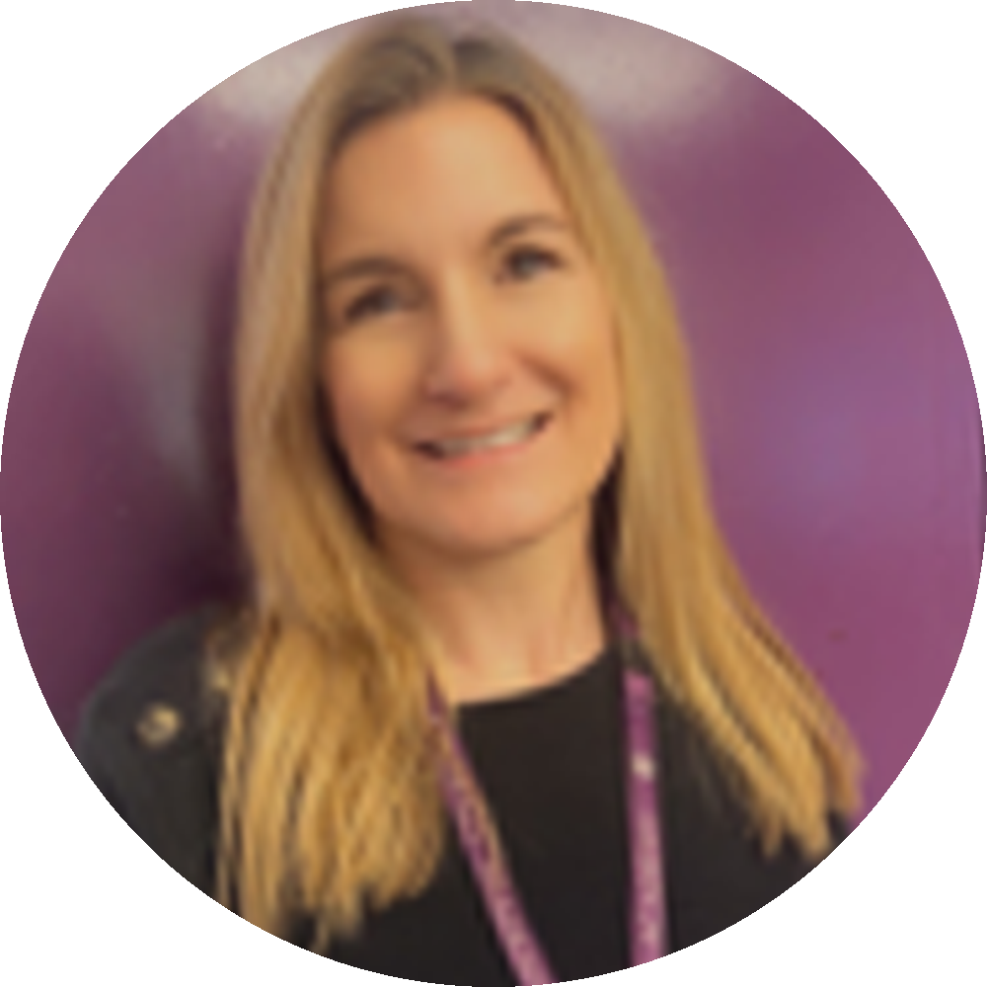

Welcome to the first edition of Infant Heads Up. This is our new style newsletter that will provide you with useful information, news of any upcoming events and also useful dates for your diary.
Thank you to all families for the fantastic start to the new school year, the children are settling very well into their new classes. Year One and Two have very quickly got back into the swing of things and our new starters in Reception and Nursery have been amazing coming in beautifully for their part-time sessions.
The Heads Up Newsletter will be posted regularly
on the Dojo whole school page.
We are all very much looking forward to
the year ahead and thank you for your
continued support
Karen Parris
Head of Academy

Slide 2


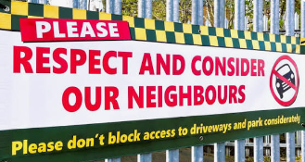
Communication
Dojo is the best way to communicate
with staff, who will endeavour to reply at
an appropriate time. There has been times where parents have messaged multiple staff with the same query. Please allow staff to reply before messaging others.
If your child is absent, please contact the school office, not Dojo so that the message gets through quickly.
Please call – 01536 264540 – we have a message service out of hours.
Alternatively, email admin@studfallinfantacademy.org
Parking
Can you please ensure that when parking, driveways are not blocked and cars not parked on the yellow lines outside the school.

Slide 3
APPLICATIONS FOR PUPIL PREMIUM & TARGETED FUNDING (2026/27)
It is incredibly important for our school that all pupils who meet the criteria apply to get the support they need—and doing so directly helps our school budget too!
Even though your child is in Reception, Year 1, or Year 2 and automatically receives a free infant school meal, please still submit an application if you meet the criteria outlined below.
A successful application generates vital Pupil Premium funding for your child's education and brings extra resources into our classrooms. We want to ensure as many families as possible benefit from this additional support. It will also provide £50 to help support trips and uniform costs (ordered by the school)
You should apply if you receive any of the following benefits:
Universal Credit: Take-home pay from work must be no more than £616.67 per month (equal to £7,400 or less a year).
Income Support
Income-based Jobseeker’s Allowance
Income-related Employment and Support Allowance
Child Tax Credit: Annual household income must be below £16,190 (and you must not receive Working Tax Credit).
Pension Credit: The Guarantee element.
Immigration Support: Support under Part VI of the Immigration and Asylum Act 1999.
(Note: Families whose children automatically get free meals because they are in Reception, Year 1, or Year 2 must still apply under these criteria for the school to get the funding).
If you are unsure, please contact the office and they will be happy to help and advise you further.

Slide 4

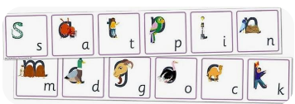
Reception and Year One Parents
Phonics Event for parents
Want to know more about how we teach reading and phonics and how you can support your child?
You are invited to a short presentation in the hall to find out more about our reading and phonics scheme, Essential Letters and Sounds ELS.
We will then visit your children in class for them to see them in action and share their books.
Reception date
Thursday 24th September at 2.15pm.
Year One date
Tuesday 29th September at 2.15pm
Please come to support this event
We look forward to seeing you there – no pre - booking needed.

Slide 5

Term 1
Tuesday 15th September
Taekwondo taster sessions for year 2 children
Thursday 24th September
Reception parent phonics and reading scheme information meeting 2.15pm
Friday 25th September
European day of Languages – children celebrate in school
Tuesday 29th September
Year one parent phonics and reading scheme information meeting 2.15pm
Monday 5th October
Year Two Harvest Festival – parents invited 2.00pm, details to follow
Tuesday 6th October – individual photographs
Thursday 8th October – year Two trip to Rockingham Castle
Wednesday 14th October – Parent consultations
Thursday 15th October – Parent Consultations
Friday 23rd October – Wear red day and close for half term

